Slide 1
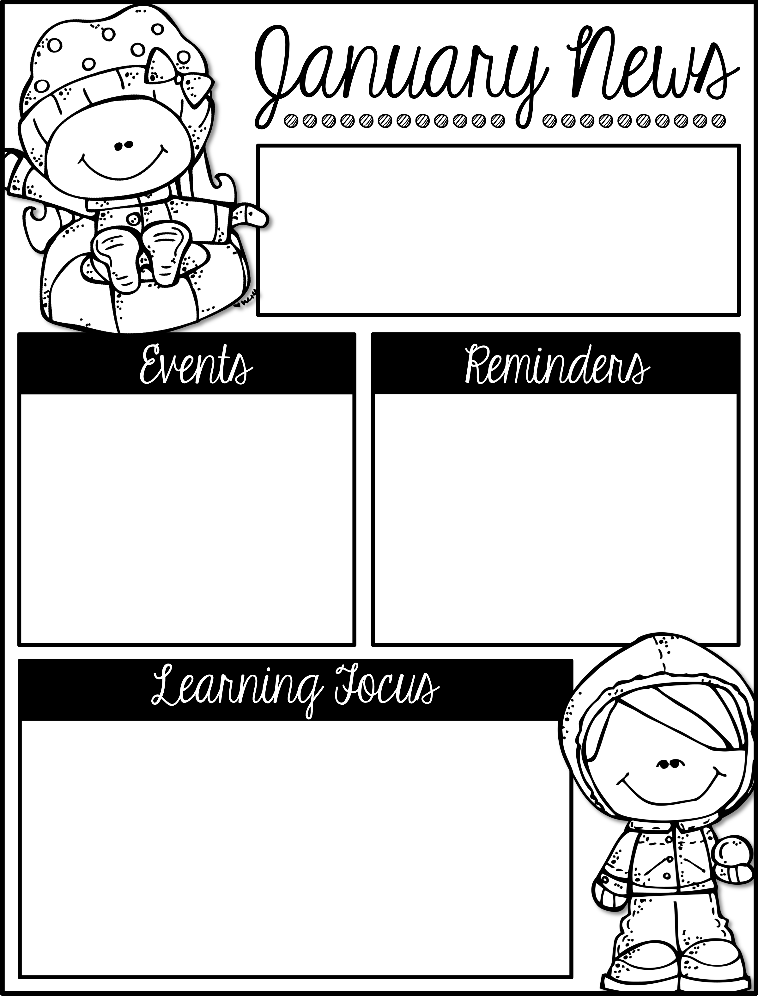
Week of January 3rd-5th
First Grade
NEW Lunch Times:
Donahue & O’Connor 11:20-11:45
Malin & Myers 11:25-11:50
January
12 1st Grade Field Trip to Planetarium
12 Snack Cart
IMPORTANT!!! Please Read!
There is a first grade field trip coming up on January 12th. It will cost $8.75 per person. We will start collecting money and send more information home after the break.
We need empty toilet paper rolls for STEM lab. Thank you!
Dress your child for the weather! It is getting COLD!
Remember to send your child in tennis shoes for P.E.
In Reading we will be describing characters, settings, and events.
In Math we will be adding and subtracting 10 from 2 digit numbers.
In Social Studies we will focus on school wide expectations.
In Writing we will be working on writing complete sentences.

Slide 2
Week of January 8th-12th
First Grade
NEW Lunch Times:
Donahue & O’Connor 11:20-11:45
Malin & Myers 11:25-11:50
January
8-9 Last Call for Field Trip Money
11 Ferdinand Movie night at Keystone
12 1st Grade Field Trip to Planetarium
12 Snack Cart
15 No School – Martin Luther King Jr. Day
We would love to see you at Movie Night at Keystone Theatre in Mt. Washington this Thursday!
We need empty toilet paper rolls for STEM lab. Thank you!
Dress your child for the weather! It is COLD!
Remember to send your child in tennis shoes for P.E.
In Reading we will identify who is telling the story at various points in the text.
In Math we will be adding and subtracting 10 from 2 digit numbers.
In Science we will be learning about the Solar System.
In Writing we will be working on writing opinion pieces.

Slide 3
Week of January 22nd-26th
First Grade
Lunch Times:
Donahue & O’Connor 11:20-11:45
Malin & Myers 11:25-11:50
January
February
2 First Grade Field Trip (This is the date we have rescheduled to)
5 No School (Teacher Planning)
19 No School (Presidents’ Day)
20 No School (Special Election)
Field Trip has been rescheduled to Friday February 2nd. All other details remain the same.
Please help your child learn to tie their shoes at home. All students should know how to tie their shoes by the end of the year.
We need empty toilet paper rolls for STEM lab. Thank you!
Remember to send your child in tennis shoes for P.E.
In Reading we will compare and contrast the experiences of the characters in texts.
In Math we will be adding and subtracting 10 from 2 digit numbers and ordering objects by length.
In Science we will be learning about the Solar System.
In Writing we will be working on writing opinion pieces.

Slide 4
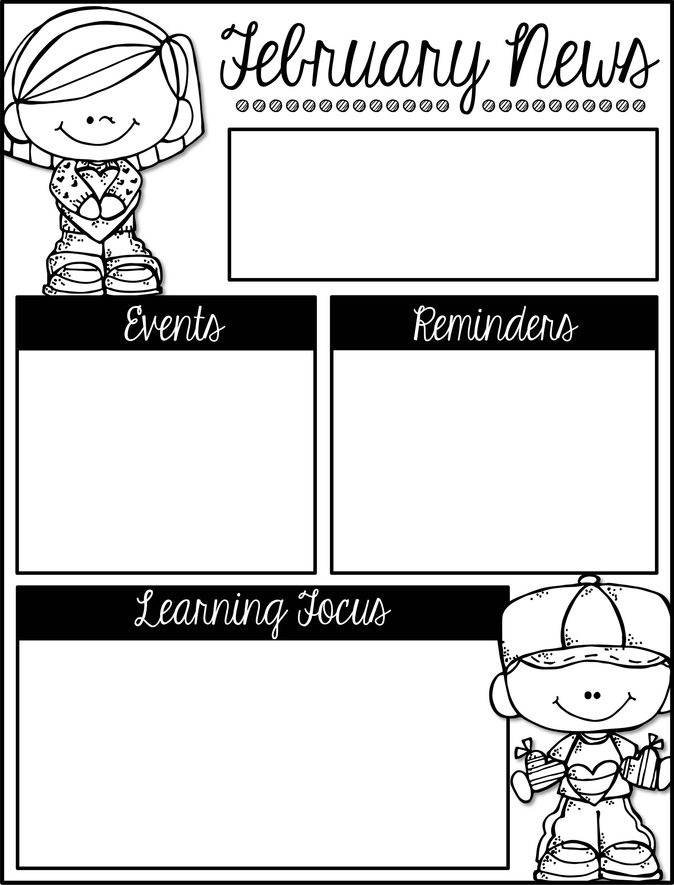
Week of Jan 29th- Feb 2nd
First Grade
Lunch Times:
Donahue & O’Connor 11:20-11:45
Malin & Myers 11:25-11:50
February
2 First Grade Field Trip (This is the date we have rescheduled to)
5 No School (Teacher Planning)
16 Snack Cart
19 No School (Presidents’ Day)
20 No School (Special Election)
Field Trip has been rescheduled to Friday February 2nd. All other details remain the same.
Please help your child learn to tie their shoes at home. All students should know how to tie their shoes by the end of the year.
Remember to send your child in tennis shoes for P.E.
In Reading we will compare and contrast the experiences of the characters in texts.
In Math we will be ordering objects by length and using non-standard units for measurement.
In Science we will be working on our class STEM Challenge.
In Writing we will be working on writing opinion pieces.

Slide 5
Week of February 6th – 9th
First Grade
Lunch Times:
Donahue & O’Connor 11:20-11:45
Malin & Myers 11:25-11:50
February
5 No School (Teacher Planning)
16 Snack Cart
19 No School (Presidents’ Day)
20 No School (Special Election)
Please help your child learn to tie their shoes at home. All students should know how to tie their shoes by the end of the year.
Remember to send your child in tennis shoes for P.E.
In Reading we will use various text features to locate key facts or information in a text.
In Math we will be representing data in a graph.
In Science we will be applying previously taught skills to a course task.
In Writing we will be working on writing opinion pieces.

Slide 6
Week of February 12th – 16th
First Grade
Lunch Times:
Donahue & O’Connor 11:20-11:45
Malin & Myers 11:25-11:50
February
14 Kindness Party (Valentines’)
16 Snack Cart
19 No School (Presidents’ Day)
20 No School (Special Election)
March
2 No School (Teacher PD day)
5 No School (Teacher Plan day)
8-16 Book Fair in Library
Please remember that it is important to read with your child at home, this will really benefit your child in the classroom.
Please help your child learn to tie their shoes at home. All students should know how to tie their shoes by the end of the year.
Remember to send your child in tennis shoes for P.E.
In Reading we will use various text features to locate key facts or information in a text.
In Math we will be representing data in a graph. We will also begin working on telling time.
In Science we will be using engineering skills to analyze and interpret data.
In Writing we will be finishing up our opinion pieces.

Slide 7
Week of February 21st– 23rd
First Grade
Lunch Times:
Donahue & O’Connor 11:20-11:45
Malin & Myers 11:25-11:50
February
Now – Feb 23 Can Good Drive
19 No School (Presidents’ Day)
20 No School (Special Election)
March
2 No School (Teacher PD day)
5 No School (Teacher Plan day)
8-16 Book Fair in Library
If you are able please send in a few canned goods with your child we are having a can good drive. It ends February 23rd.
Please remember that it is important to read with your child at home, this will really benefit your child in the classroom.
In Reading we will begin identifying similarities and differences between two text on the same topic.
In Math We will be working on telling time to the hour and half hour.
In Science we will be learning about healthy choices for our hearts and bodies.
In Writing we will be using prepositions and end punctuation.

Slide 8
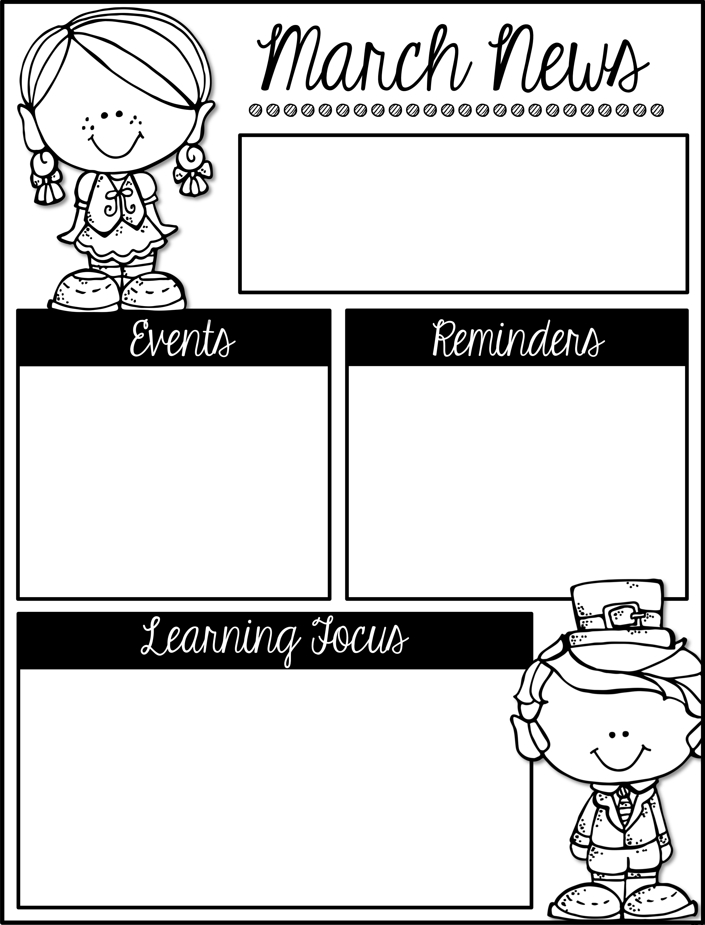
Week of Feb 26th– Mar 2nd
First Grade
Lunch Times:
Donahue & O’Connor 11:20-11:45
Malin & Myers 11:25-11:50
With wide spread flu and other viruses going around right now, please be aware of a district policy that students must be fever free for 24 hours before returning to school.
In our previous Newsletter we stated that there was no school on March 2nd, however we DO have school this day. It is being used as a make-up day.
March
2 We have school (Make-up day)
5 No School (Teacher Plan day)
8-16 Book Fair in Library
In Reading we will begin identifying similarities and differences between two text on the same topic.
In Math We will be working on telling time to the hour and half hour.
In Science we will be using previously taught content to complete a through course task.
In Writing we will begin writing our how-to pieces.

Slide 9
Week of March 6th– 9th
First Grade
Lunch Times:
Donahue & O’Connor 11:20-11:45
Malin & Myers 11:25-11:50
March
5 No School (Teacher Plan day)
8-16 Book Fair in Library
12-16 Literacy week
16 Snack Cart
20 Literacy Night 5:30-7:30
29 Storybook night 7pm
30 Snack Cart
A paper was sent home with details about our upcoming Literacy week. You may also refer to the calendar on the back of this newsletter.
With wide spread flu and other viruses going around right now, please be aware of a district policy that students must be fever free for 24 hours before returning to school.
In Reading we will begin distinguishing between information provided by pictures and information provided by the words in a text.
In Math We will be learning about 2D and 3D shapes and their attributes.
In Social Studies we will be learning about economics.
In Writing we will begin writing our informational pieces.

Slide 10
Week of March 12th– 16th
First Grade
Lunch Times:
Donahue & O’Connor 11:20-11:45
Malin & Myers 11:25-11:50
March
8-16 Book Fair in Library
12-16 Literacy week
16 Snack Cart
16 Book Fair Family Night 6-8pm
20 Literacy Night 5:30-7:30
29 Storybook night 7pm
30 Snack Cart
Literacy Week
Monday – Dress Down and carry a poem in your pocket (we will provide poems if needed)
Tuesday – Support your favorite team by wearing their gear and teaming up with a good book
Wednesday – Dress up as your future career.
Thursday- Dress up with your friends as your favorite characters
Friday- Dress up as a character from your classes chosen book
In Reading we will identify main topic and retell key details along with using illustrations to describe key ideas.
In Math We will be learning about 3D shapes and their attributes.
In Social Studies we will continue learning about economics.
In Writing we will continue writing our informational pieces.

Slide 11
Week of March 19th– 23rd
First Grade
Lunch Times:
Donahue & O’Connor 11:20-11:45
Malin & Myers 11:25-11:50
March
23 Snack Cart
20 Literacy Night 5:30-7:30
29 Storybook night 7pm
30 Snack Cart
April
2-6 Spring Break
9 No School (Teacher Plan Day)
Remember if your child signed up to be at Storybook night on the 29th they need to arrive at 6:30. The show will start at 7.
Tennis shoes must be worn for your child to participate in P.E.
In Reading we will describe the connection between two individuals, events, ideas, or pieces of information in a text. .
In Math We will continue learning about 2D & 3D shapes and their attributes.
In Social Studies we will continue learning about economics.
In Writing we will continue writing our informational pieces.

Slide 12
Week of March 26th– 30th
First Grade
Lunch Times:
Donahue & O’Connor 11:20-11:45
Malin & Myers 11:25-11:50
March
29 Storybook night 7pm
30 Snack Cart
April
2-6 Spring Break
9 No School (Teacher Plan Day)
13 Snack Cart
27 Snack Cart
Remember if your child signed up to be at Storybook night on the 29th they need to arrive at 6:30. The show will start at 7.
Tennis shoes must be worn for your child to participate in P.E.
In Reading we will describe the connection between two individuals, events, ideas, or pieces of information in a text. .
In Math we will be working on review.
In Social Studies we will continue learning about economics.
In Writing we will continue writing our informational pieces.

Slide 13
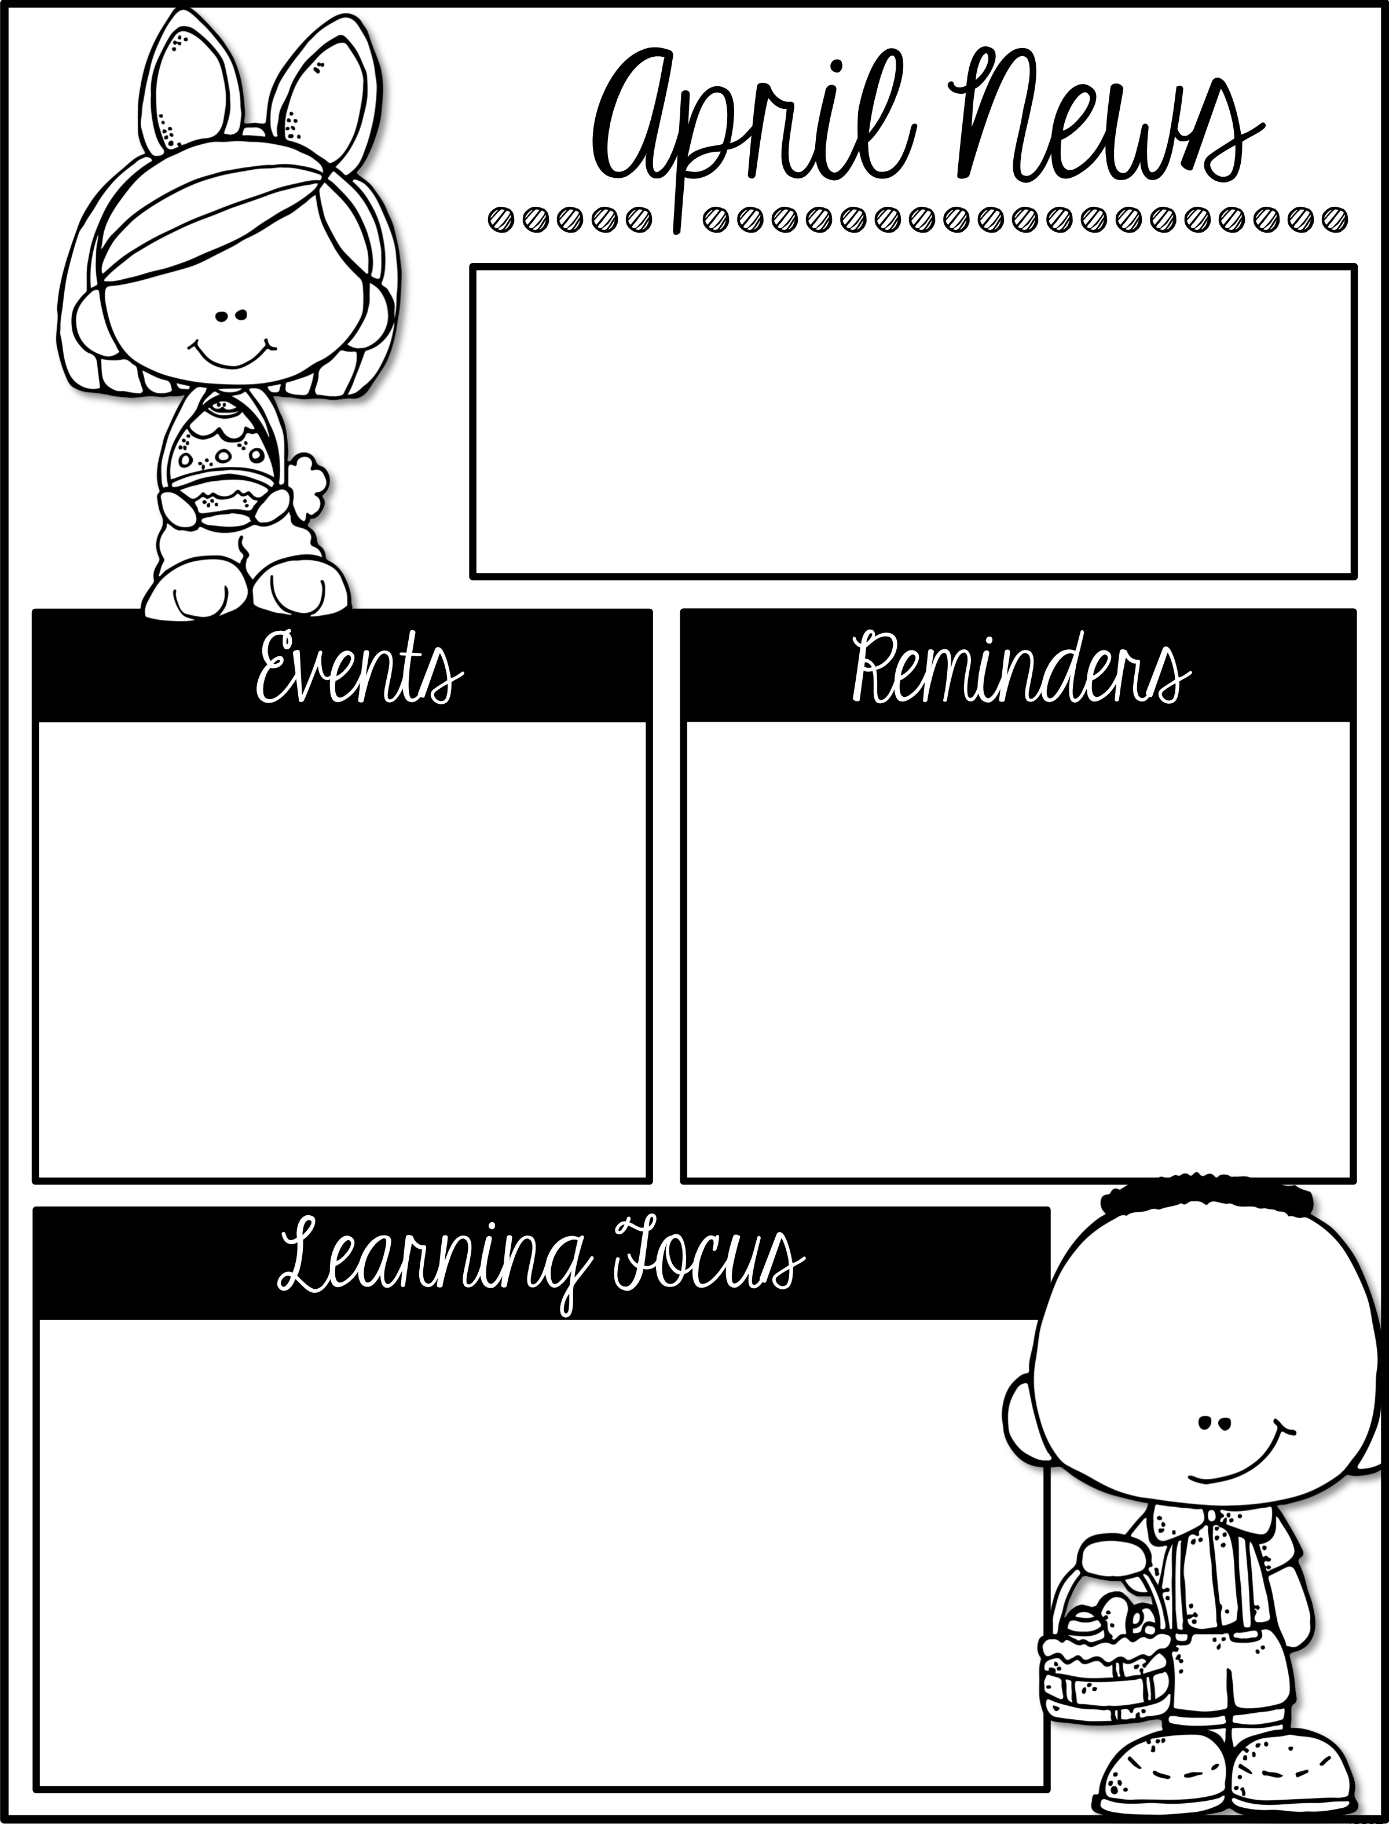
Week of April 10th– 13th
First Grade
Lunch Times:
Donahue & O’Connor 11:20-11:45
Malin & Myers 11:25-11:50
April
2-6 Spring Break
9 No School (Teacher Plan Day)
13 Snack Cart
27 Snack Cart
We are going to begin a Pete the Cat Shoe tying “club” for our first graders. The students who can tie their shoes will get their name on the wall next to Pete the Cat in the first grade hallway. They will also get a tag for their backpack. They will have the opportunity to show their shoe tying skills once a month.
In Reading we will ask and answer questions to determine the
meaning of a Unknown word in a text.
In Math we will be counting on and adding within 100.
In Social Studies we will be learning about historical perspective.
In Writing we will finish writing our informational pieces.

Slide 14
Week of April 16th– 20th
First Grade
Lunch Times:
Donahue & O’Connor 11:20-11:45
Malin & Myers 11:25-11:50
April
13 No School
27 Snack Cart
May
4 No school
Keep practicing tying shoes at home.
Even though we do not have assigned homework please continue to work on reading with your child at home.
Attendance is very important to your child's academic growth. Please make sure your child is here unless they are sick.
In Reading we will be explaining major differences between books that tell stories and books that give information.
In Math we will be counting on and adding within 100.
In Social Studies we will be learning about historical perspective in the United States.
In Writing we will continue to finish writing our informational pieces.

Slide 15
Week of April 23rd– 27th
First Grade
Lunch Times:
Donahue & O’Connor 11:20-11:45
Malin & Myers 11:25-11:50
April
27 School Spirit Dress Down
27 Snack Cart
May
Apr 30-3 Derby Week Activities
3 Art Gala 6-8pm
4 No school
Please make sure your child is leaving all toys at home. They are becoming a distraction during school and we are not responsible for lost, stolen, or traded toys.
Attendance is very important to your child's academic growth. Please make sure your child is here unless they are sick.
In Reading we will be explaining major differences between books that tell stories and books that give information.
In Math we will be counting on and adding within 100.
In Social Studies we will be learning about historical perspective in the United States.
In Writing we will be learning about and using articles and demonstratives.

Slide 16
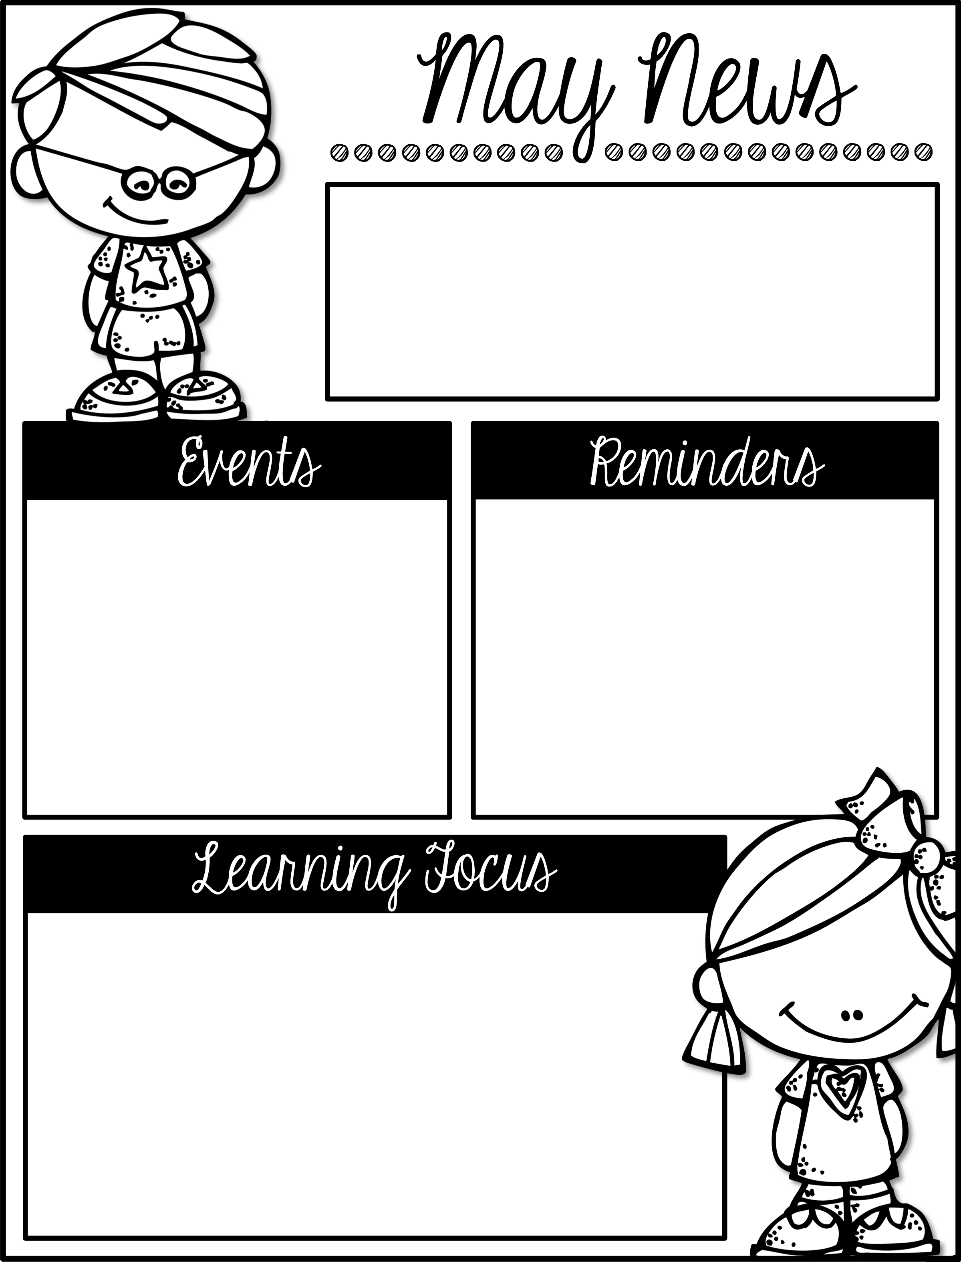
Week of April 30th– May 3rd
First Grade
Lunch Times:
Donahue & O’Connor 11:20-11:45
Malin & Myers 11:25-11:50
May
2 Field Trip Money Due
3 Art Gala 6-8pm
4 No school
11 First grade field trip
22 No school
28 No School
June
4 1st grade end of year celebration 1:15-2:15
6 Field Day
8 Last Day of School
There are a lot of important dates coming up with the end of the year quickly approaching.
Continue to read with your child at home as much as you can to help them get ready for 2nd grade.
In Reading we will be identifying the reasons an author gives to support points in a text.
In Math we will be subtracting within 20 using story problems.
In Social Studies we will be learning about plants and animals needs.
In Writing we will be focusing on vocabulary and figuring out the meaning of “new to us” words.

Slide 17
Week of May 7th– 11th
First Grade
Lunch Times:
Donahue & O’Connor 11:20-11:45
Malin & Myers 11:25-11:50
May
4 No school
11 First grade field trip
22 No school
28 No School
June
4 1st grade end of year celebration 1:15-2:15
6 Field Day
8 Last Day of School
Remember Friday is our field trip. Send your child in our class t-shirt and tennis shoes that can get muddy. Remember we will be outside on a farm so pay attention to the weather and dress your child appropriately.
In Reading we will be identifying basic similarities in and differences between two texts on the same topic .
In Math we will be subtracting within 20 using different strategies.
In Social Studies we will be learning about plants and animals needs.
In Writing we will be focusing on vocabulary and figuring out the meaning of “new to us” words.

Slide 18
Week of May 14th– 18th
First Grade
Lunch Times:
Donahue & O’Connor 11:20-11:45
Malin & Myers 11:25-11:50
May
14 Snack Cart
18 Dress Down Day
18 Snack Cart
21-29 KPREP Testing (3rd-5th grade only)
22 No school
28 No School
June
May 30- 5
BOGO Book Fair
4 1st grade end of year celebration 1:15
6 Field Day
8 Last Day of School
Continue to work with your child on tying their shoes. They still have time to make it into the Pere the Cat Tying Shoes Club
Please pay close attention to all the dates on our newsletter. With the end of the year quickly approaching we have several activities coming up.
In Reading we will be comparing and contrasting the experiences of characters.
In Math we will be subtracting within 20 using different strategies.
In Social Studies we will be playing STEM games that involve plant and animal adaptations.
In Writing we will be focusing on vocabulary and defining words by category and at least one attribute.

Slide 19
Week of May 21st– 25th
First Grade
Lunch Times:
Donahue & O’Connor 11:20-11:45
Malin & Myers 11:25-11:50
May
21-29 KPREP Testing (3rd-5th grade only)
22 No school
28 No School
June
May 30- 5
BOGO Book Fair
4 1st grade end of year celebration 1:15
6 Field Day
8 Last Day of School
Students will need to wear their class shirt on June 4th for our end of year celebration.
Continue to work with your child on tying their shoes. They still have time to make it into the Pete the Cat Tying Shoes Club.
In Reading we will identify words and phrases in stories or poems that suggest feelings or appeal to the senses.
In Math we will continue subtracting within 20 using different strategies.
In Science we will be learning about patterns of plants and animals that help offspring survive and offspring isn't exactly like their parents.
In Writing we will distinguish the shades of meaning among verbs and adjectives differing in intensity by defining them or by acting out the meanings.

Slide 20
Week of May 29th– June 1st
First Grade
Lunch Times:
Donahue & O’Connor 11:20-11:45
Malin & Myers 11:25-11:50
May
29 KPREP Testing Wraps up (3rd-5th grade only)
28 No School
June
May 30- 5
BOGO Book Fair
4 1st grade end of year celebration 1:15
6 Field Day
8 Last Day of School
Students will need to wear their class shirt on June 4th for our end of year celebration.
Continue to work with your child on tying their shoes. They still have time to make it into the Pete the Cat Tying Shoes Club.
In Reading we will identify words and phrases in stories or poems that suggest feelings or appeal to the senses.
In Math we will be reviewing math content.
In Science we will be learning about patterns of plants and animals that help offspring survive and offspring isn't exactly like their parents.
In Writing we will identify frequently occurring suffixes and what they make words mean.

Slide 21
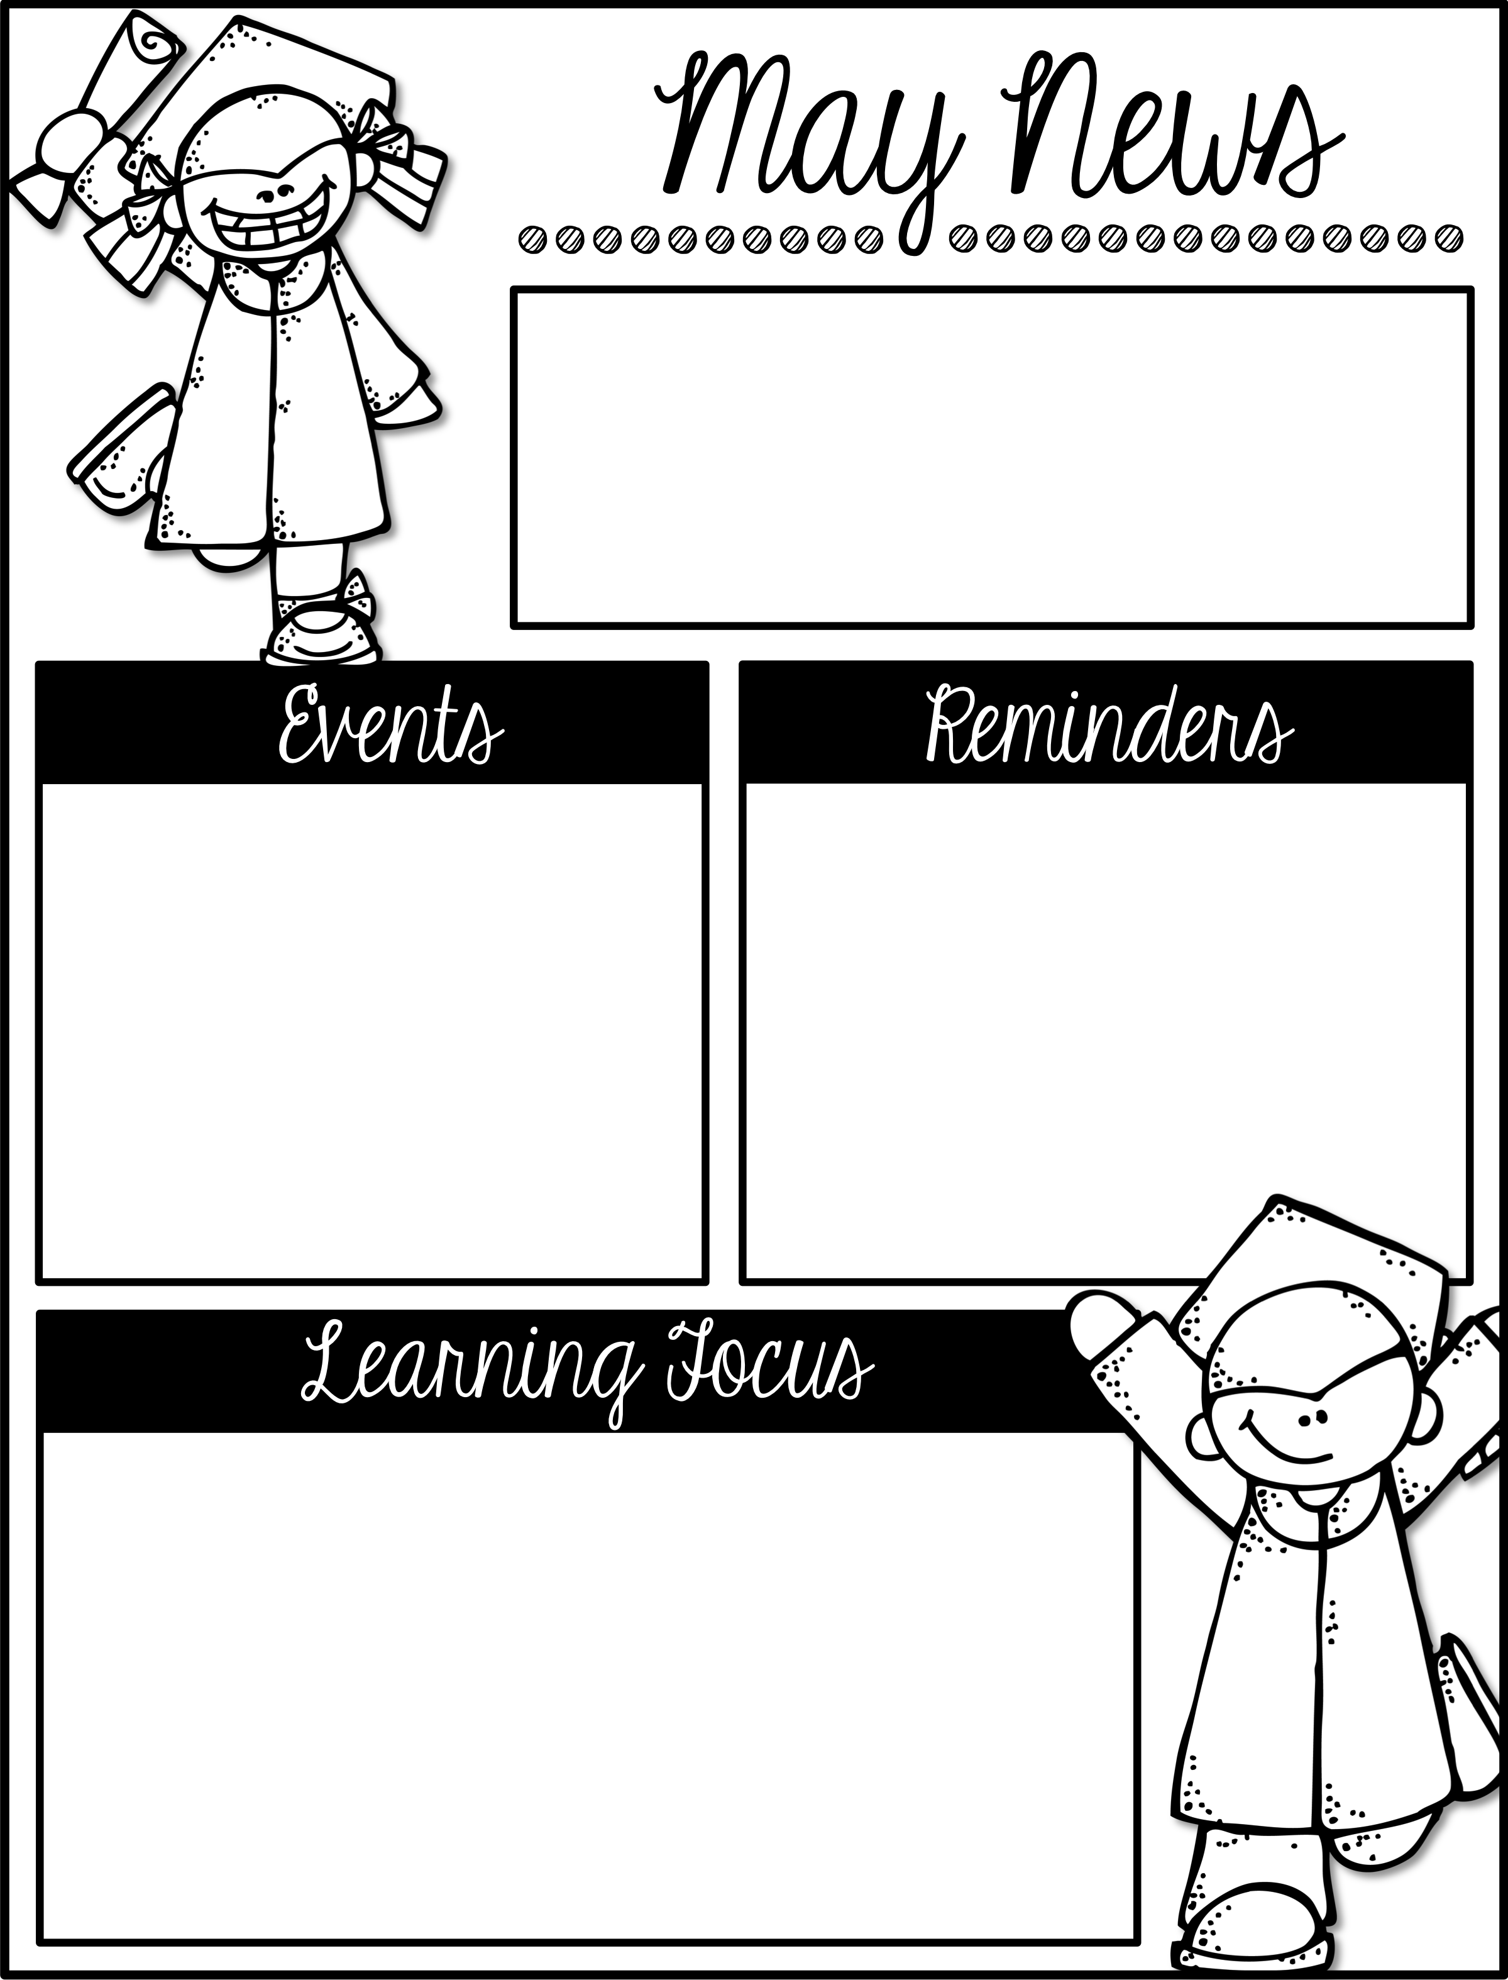
Type Here
Type Here
Type Here
Type Here
Type Here

Slide 22

Type Here
Type Here
Type Here
Type Here
Type Here

Slide 23
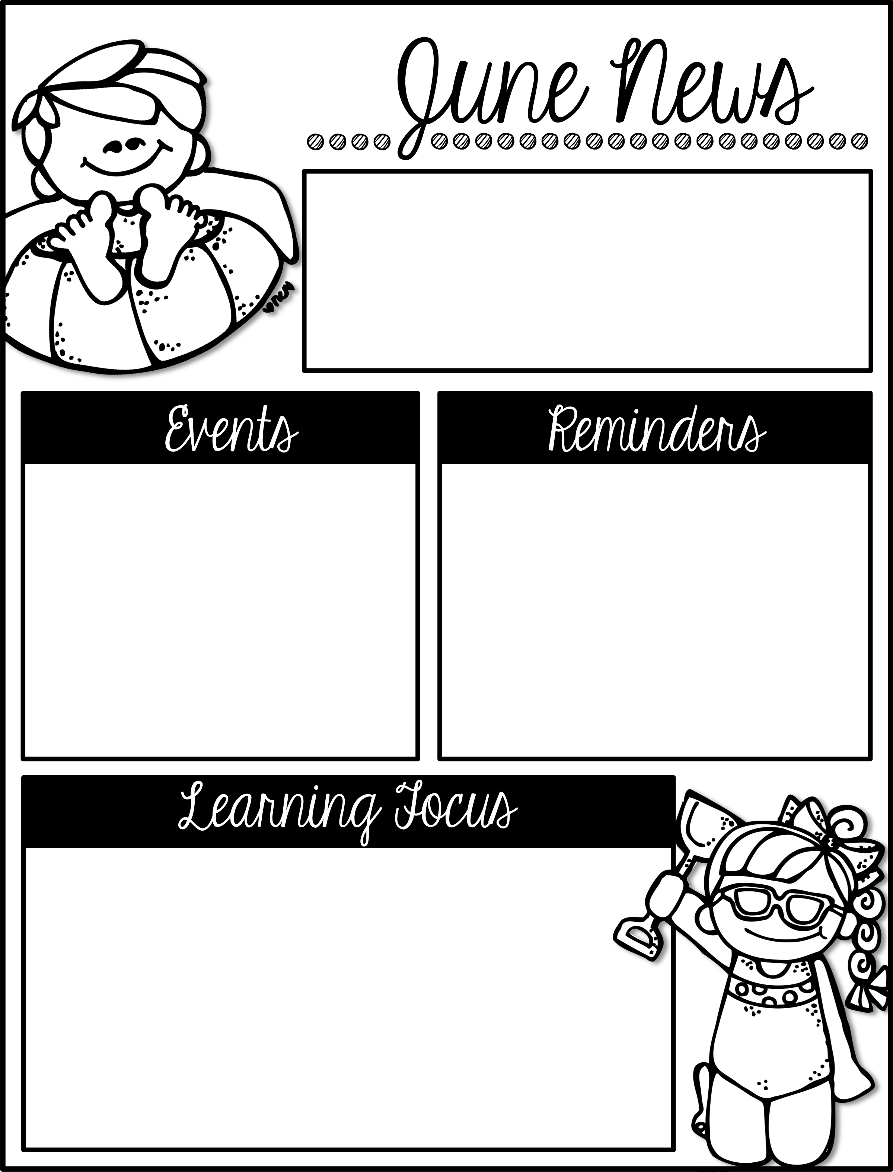
Week of June 4th–8th
First Grade
Lunch Times:
Donahue & O’Connor 11:20-11:45
Malin & Myers 11:25-11:50
June
May 30- 5
BOGO Book Fair
4 1st grade end of year celebration 1:15
6 Field Day
8 Last Day of School
Remember to wear class shirt on June 4^{th!}
Have a wonderful summer! Continue to practice reading, writing, and math over the summer so you come back 2nd grade ready!
In Reading we will be reviewing and preparing for 2nd grade.
In Math we will be reviewing math content.
In Science we will be doing fun end of the year science experiments.
In Writing we will continue working on writing skills so we are prepared for 2nd grade.

Slide 24
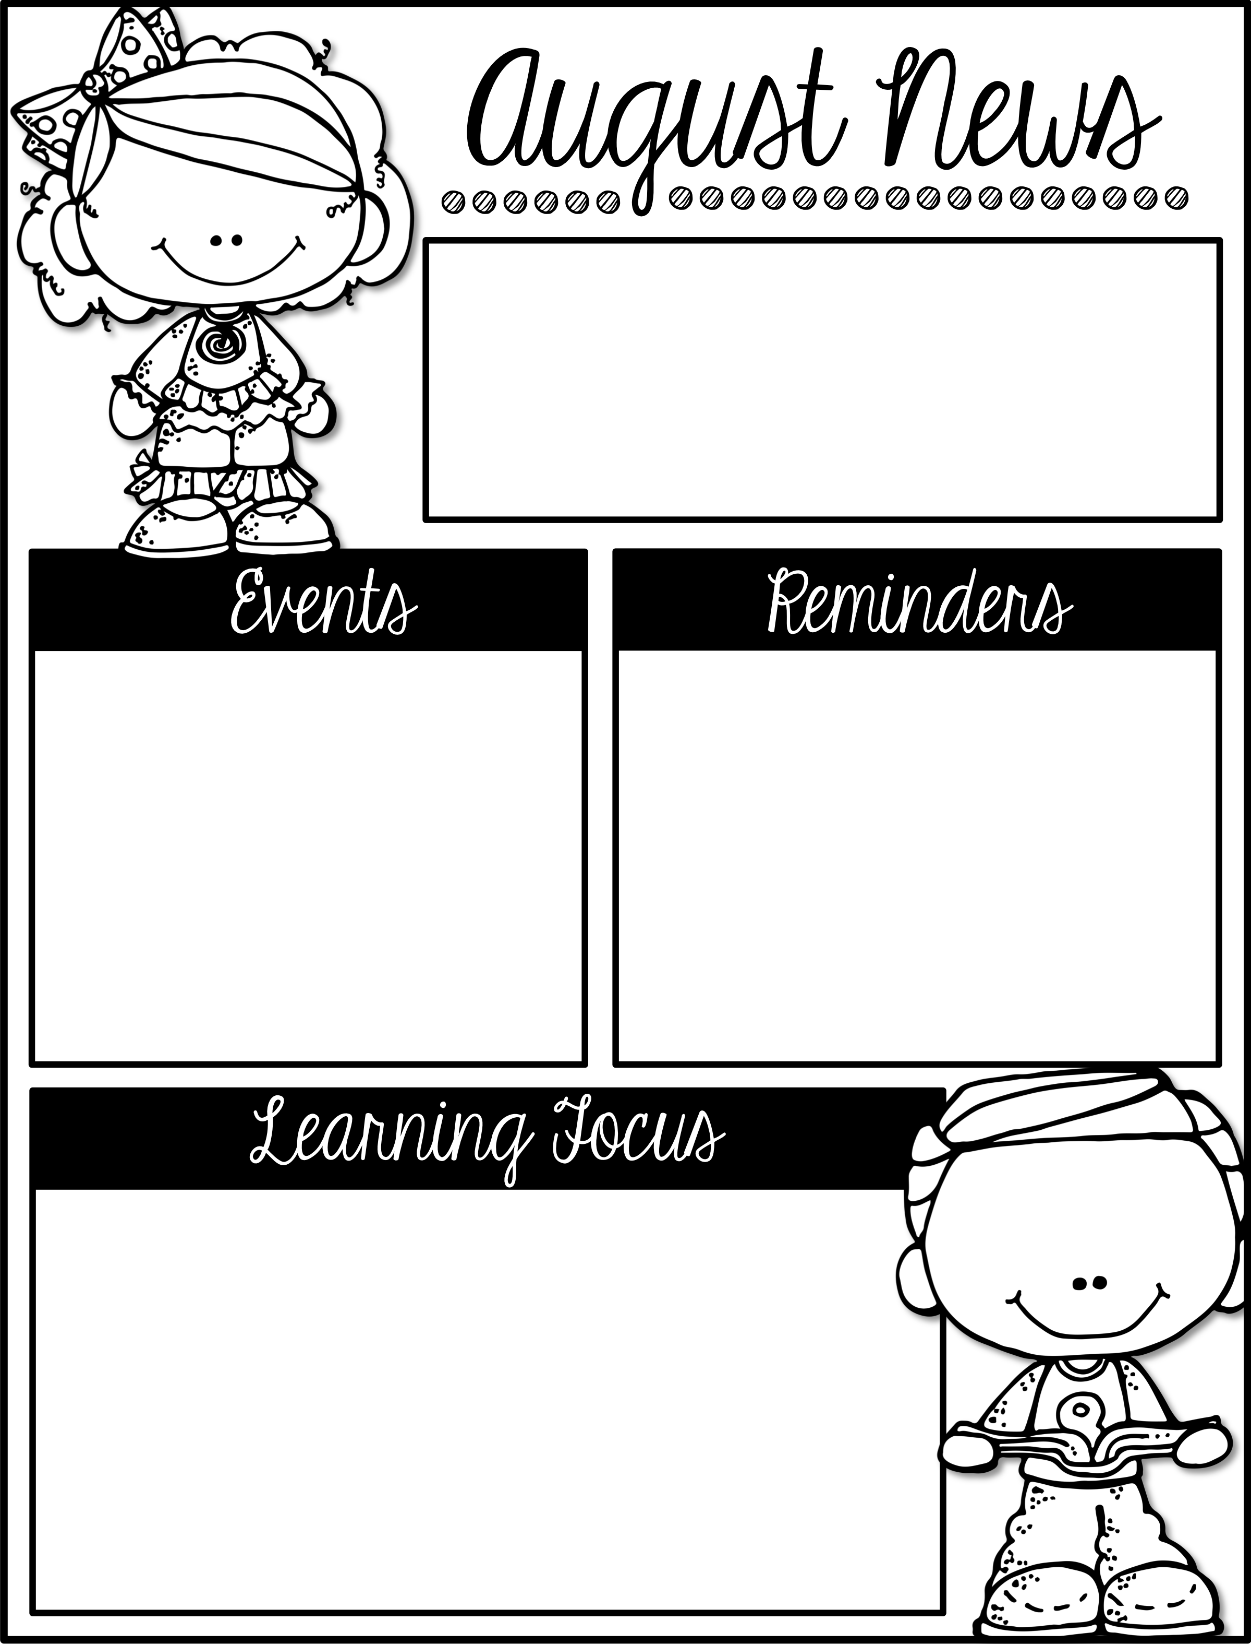
Week of August 20th-24th
First Grade
Lunch Times:
Donahue & Malin 11:15-11:40
O’Connor11:20-11:45
August
24 Candy Pencil Delivery Day
31 Snack Cart
Welcome to First Grade! We are so glad to have you as part of our first grade family!
This is our newsletter that you will receive every Friday.
If you have not already, please get all beginning of the year paperwork completed and sent back in.
In Reading we will be retelling stories including their key details.
In Math we will be reviewing numbers and number sense.
In Science we will be learning about being part of a community and following rules and laws.
In Writing we will be working on writing personal narratives.

Slide 25
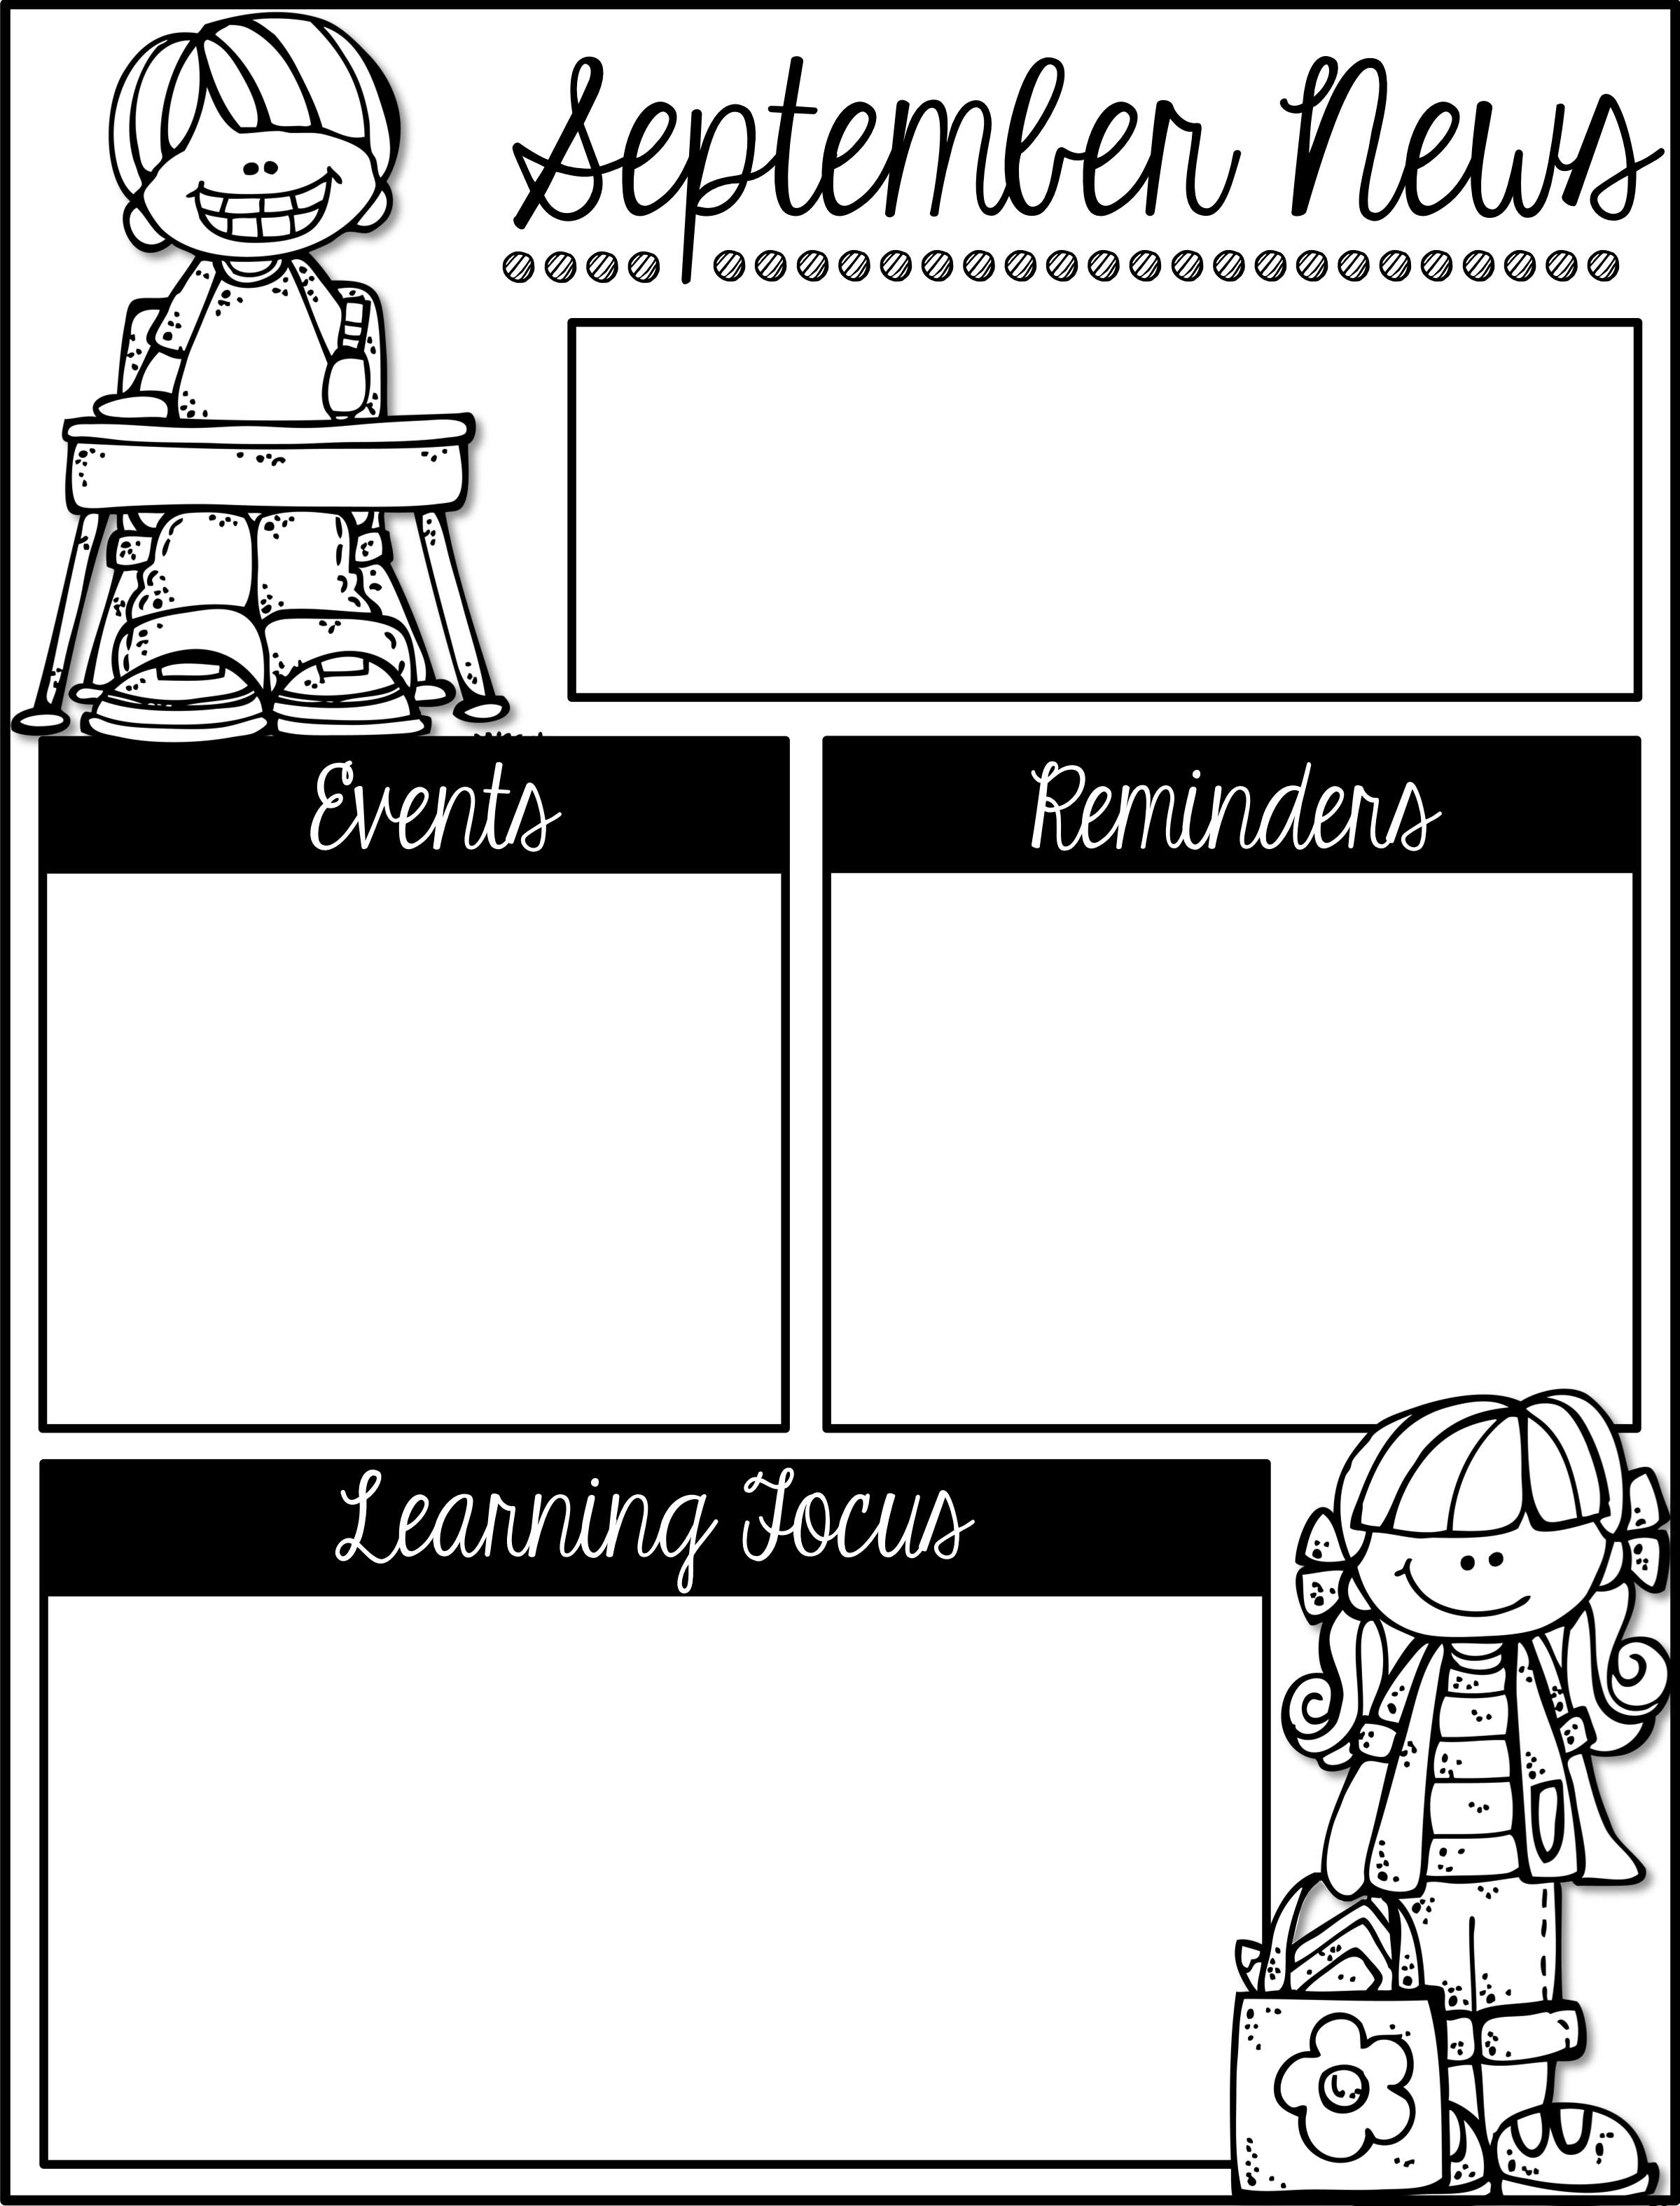
Week of August 20th-24th
First Grade
Lunch Times:
Donahue & Malin 11:15-11:40
O’Connor11:20-11:45
September
No School Labor Day
No School
First Day of NEW classes (if your child is switching)
14 Snack Cart
Remember to check your child’s planner every night.
Practice tying shoes.
In Reading we will be asking and answering questions about key details in a text.
In Math we will be adding and subtracting within 20.
In Social Studies we will be learning about being part of a community.
In Writing we will continue writing personal narratives. We will also be identifying nouns.

Slide 26
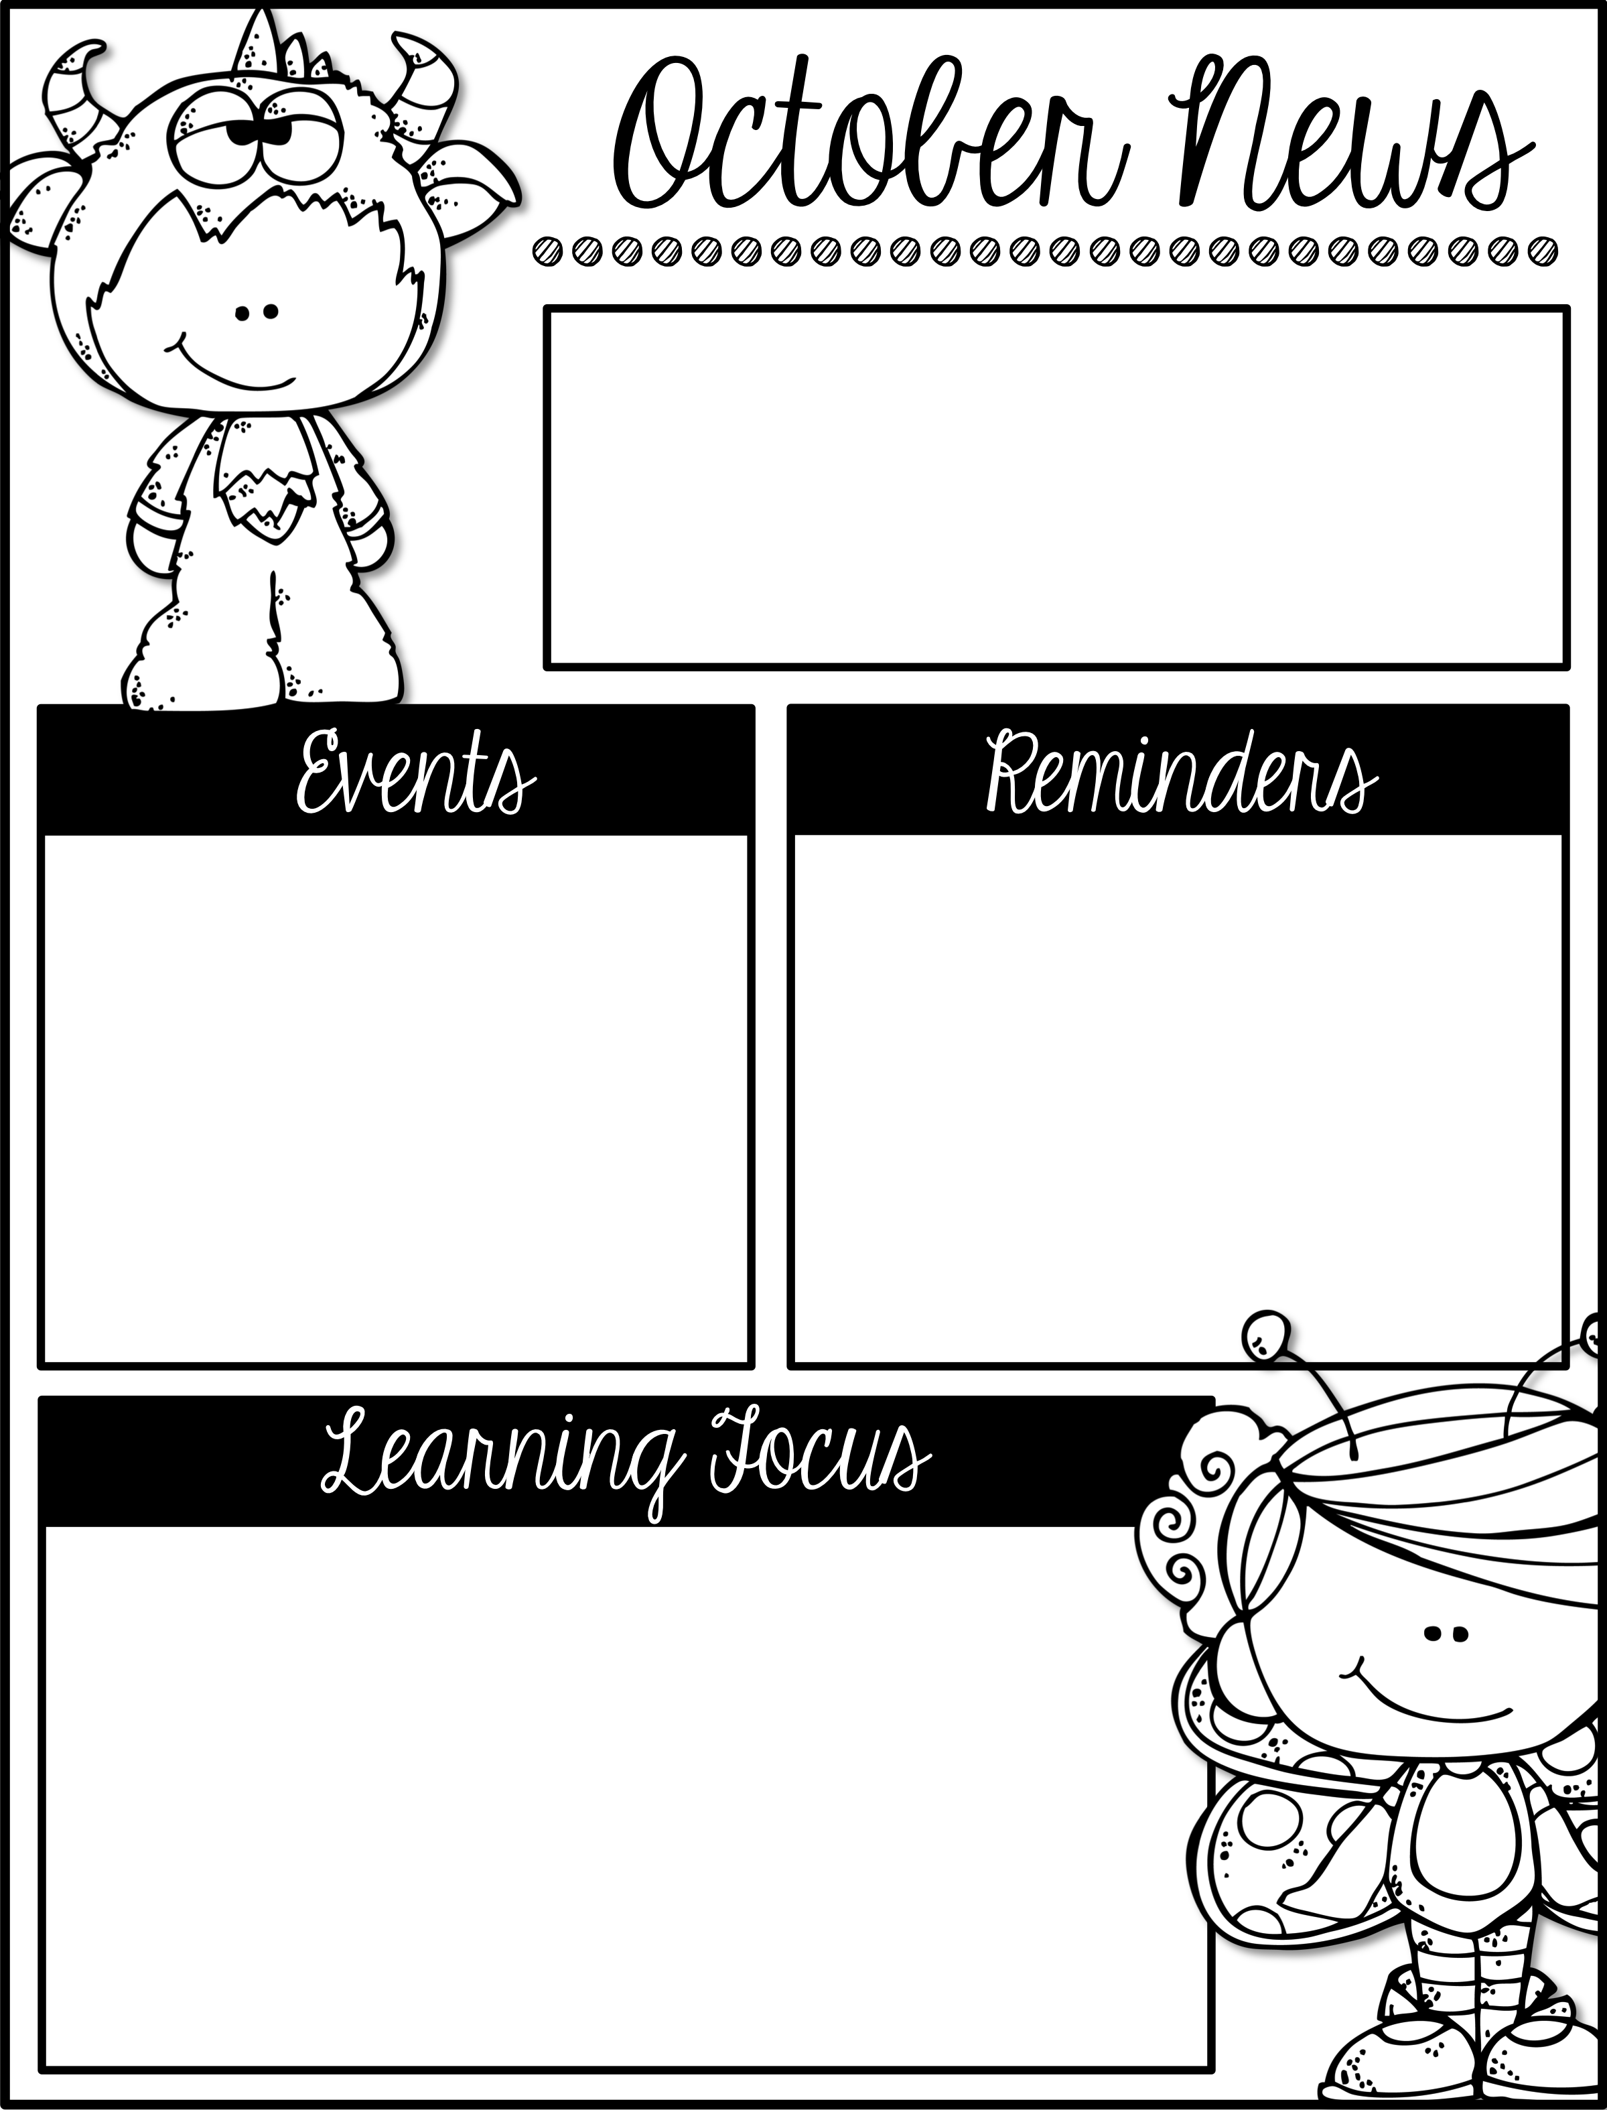
Week of October 22nd-26th
First Grade
Lunch Times:
Malin 11:15-11:40
O’Connor11:20-11:45
Fall Parties will be held on Wednesday, October 31st. Your teacher will give you specific details.
Remember to check your child’s planner every night. These are stamped each day to let you know how your child is doing.
Practice tying shoes!
Colder weather is here! Make sure your child is dressed for the weather.
In Reading we will be identifying the main idea and key details in a text.
In Math we will be solving story problems and adding and subtracting within 20.
In Science we will be learning about the life cycles of plants.
In Writing we are writing an opinion piece about what we want to be when we grow up. We will also be identifying nouns.

Slide 27
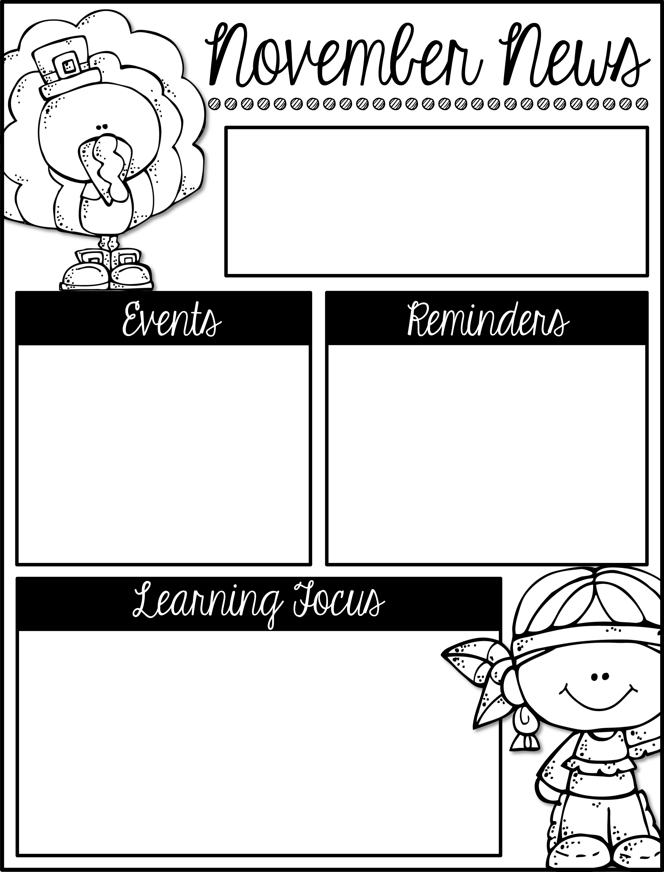
Week of December
First Grade
Lunch Times:
Malin 11:15-11:40
O’Connor11:20-11:45
Type Here
Type Here
Type Here
Type Here

Slide 28
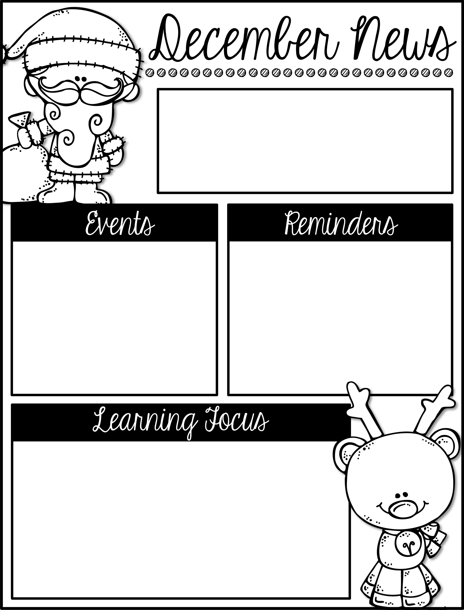
Week of December 3-7th
Lunch Times:
Malin 11:15-11:40
O’Connor11:20-11:45
December
7 Snack Cart
5-7 Santa Shop
21 Class Christmas Parties
Dec 21-Jan 4 No School (Christmas Break)
.
If the temperature is 32 degrees or higher, we go outside for recess. Please make sure your child is dressed appropriately!
In Reading we will be retelling stories and determining who is telling the story.
In Math we are working on place value (the ones and tens place
In Social Studies we will continue to learn about cultures and systems of beliefs.
In Writing we are writing letters.

